Slide 1


Oleg Kontchaev
May 2, 2022

Slide 2

Outline
Executive Summary
Introduction
Methodology
Results
Conclusion
Appendix

Slide 3
Executive Summary
Summary of methodologies
Data Collection with API and WebScraping
Data Wrangling
Exploratory Data Analysis with SQL and Pandas
Visualization of Exploratory Data Analysis with Matplotlib
Interactive Visual Analytics and Dashboard
Predictive Analysis with Machine Learning (Classification)
Summary of all results
Exploratory Data Analysis results
Predictive Analysis results

Slide 4
Introduction
Project background and context
SpaceX is able to launch “Falcon 9” rockets with a cost of 62 million dollars while its competitors launches for 165 million dollars. A great deal of this difference is SpaceX can reuse the first stage of the launch. For this reason, if we can determine the result of landing status of first stage, we can determine the cost of a launch as well.
Problems you want to find answers
In this project , our objective is to train machine learning models with publicly available data so that we can determine whether the first stage will be reusable or not. Thus estimate the cost of the launch.

Slide 5

Section 1

Slide 6
Methodology
Executive Summary
Data collection methodology:
Data was collected by using 2 methods: SpaceX API and web scraping(Wikipedia)
Perform data wrangling
One hot encoding and dropping of irrelevant columns was performed
Perform exploratory data analysis (EDA) using visualization and SQL
Perform interactive visual analytics using Folium and Plotly Dash
Perform predictive analysis using classification models
The data was split into training and test sets. Four different classification models were built. Then, the accuracy of each model was evaluated.

Slide 7
Data Collection
The data collection included the following steps:
Get request to the SpaceX API
Decoded the response content using .json() function call and turn it into a pandas dataframe with
.json_normalize()
Cleaned the data of missing values
Web scraping from Wikipedia for Falcon 9 launch data using BeautifulSoup
Take the HTML table and convert it to a pandas dataframe for analysis

Slide 8
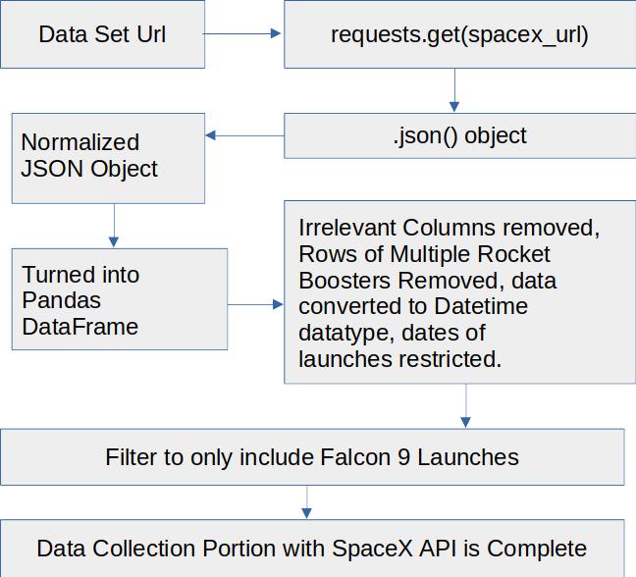
Data Collection – SpaceX API
Key phrases and flowchart is to the right
The link to GitHub: https://github.com/okontchaev/Applied-Data-Science-Capstone-Project/blob/c273fa6720a0cf16ee206d6274d85edb14eb2acb/jupyter-labs-spacex-data-collection-api%20(2).ipynb

Slide 9
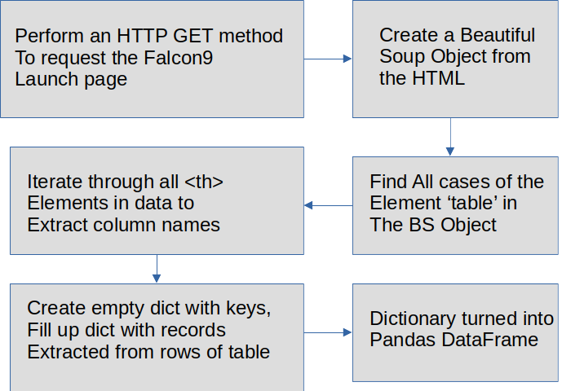
Data Collection - Scraping
Webscraping flowchart is to the right
The link to GitHub: https://github.com/okontchaev/Applied-Data-Science-Capstone-Project/blob/main/jupyter-labs-webscraping%20(1).ipynb

Slide 10
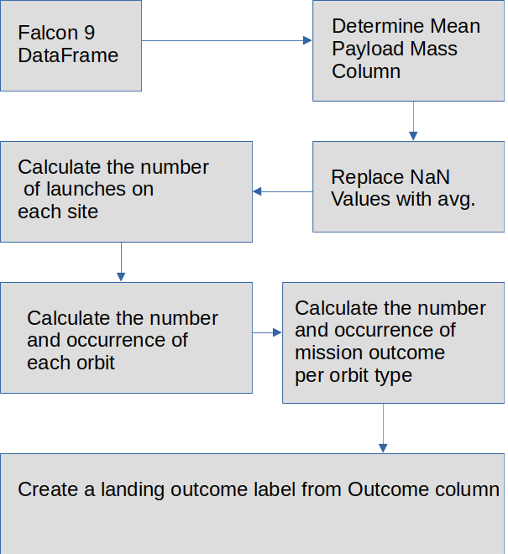
Data Wrangling
Performed Exploratory Data Analysis, determined the training labels, summarized the number of launches at each site, and occurrence of each orbit, then created landing outcome labels from outcome column
Data Wrangling flowchart is to the right
The link to GitHub: https://github.com/okontchaev/Applied-Data-Science-Capstone-Project/blob/main/labs-jupyter-spacex-Data%20wrangling%20(1).ipynb

Slide 11
EDA with Data Visualization
Graphs being drawn:
Scatter Graphs: Flight Number VS. Payload Mass, Flight Number VS. Launch Site, Payload VS. Launch Site, Orbit VS. Flight Number, Payload VS. Orbit Type, Orbit VS. Payload Mass
Bar Graph: Mean vs. Orbit
Line Graph: Success Rate vs. Year
The link to GitHub: https://github.com/okontchaev/Applied-Data-Science-Capstone-Project/blob/main/jupyter-labs-eda-dataviz%20(1).ipynb

Slide 12
EDA with SQL
SQL queries results
Displaying unique launch sites in the space mission
Displaying initial 5 records in the data where the launch sites begin with string ‘CCA’
Calculating total booster payload launched by NASA (CRS)
Showing the average payload mass carried by booster F9 v1.1
Finding the date of the first successful ground pad landing outcome
Listing booster names with payload between 4000 –6000 kg and landing outcome a success in drone ships
Displaying total number of successful and failed rocket launch outcomes
Listing booster names that carried highest payload mass
Displaying launch site names and booster versions that produced fail drone ship landing outcomes in 2015
Listing count of each landing outcome (e.g., Failure (drone ship)) in descending order between dates 4/6/2010 and 20/3/2017
The link to GitHub: https://github.com/okontchaev/Applied-Data-Science-Capstone-Project/blob/main/jupyter-labs-eda-sql(1).ipynb

Slide 13
Build an Interactive Map with Folium
Map objects created and added to a folium map
site_map.add_child(circle) was used to add circles
site_map.add_child(marker) was used to add markers
site_map.add_child(lines) was used to add lines
Those objects were added to pinpoint locations of launch sites, calculate distances, mark the outcome of launches for each site on the folium map
The link to GitHub: https://github.com/okontchaev/Applied-Data-Science-Capstone-Project/blob/main/lab_jupyter_launch_site_location%20(1).ipynb

Slide 14
Build a Dashboard with Plotly Dash
Plots/graphs and interactions added to a dashboard:
A pie chart and a scatter chart were added
Charts were added to show:
pie chart - the total successful launches count for all sites
scatter chart - the correlation between payload and launch success
The link to GitHub: https://github.com/okontchaev/Applied-Data-Science-Capstone-Project/blob/main/labs%20spacex%20project%20-%20dashboard%20-%20Plotly%20Dash.py

Slide 15
Predictive Analysis (Classification)
Fit and transform features
Original dataset was split to 80%:20% train-test subsets
Find optimal parameters for the models
Try models on test dataset
Visualize results with Confusion Matrix
The data were loaded, transformed , and split into training and testing sets. Then different machine learning models were built and tuned. The accuracy was used as the metric for all models. Found optimal parameters for the models. Finally, the best performing model was determined.
The link to GitHub: https://github.com/okontchaev/Applied-Data-Science-Capstone-Project/blob/main/SpaceX_Machine%20Learning%20Prediction_Part_5%20(1).ipynb

Slide 16
Results
Exploratory data analysis results:
CCAFS LC-40, has a success rate of 60 %, KSC LC-39A and VAFB SLC 4E have a success rate of 77%
ES-L1, SSO, HEO, and GEO has the highest success rate of 1.0 = 100%
With Geo and MEO, greater success over time. Others see no difference over time
Polar, LEO, and ISS Orbits, when launching heavy payloads, have a greater success rate
Predictive analysis results: Decision Tree Classifier had the highest accuracy of 87.5%

Slide 17

Section 2

Slide 18

Flight Number vs. Launch Site
The chart shows a distribution of flights among three different launch sites. Color shows success vs failure. As we can see, the failure percentage is declining over time(Flight Number) for all sites

Slide 19
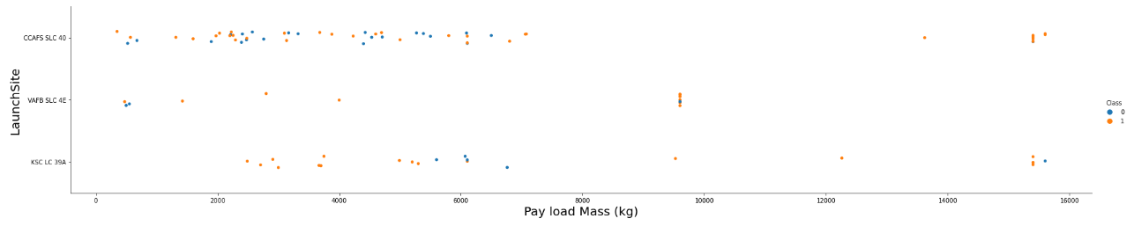
Payload vs. Launch Site
As we can see on Pay load vs Launch Site chart, the greater mass correlates with a success of the flight

Slide 20
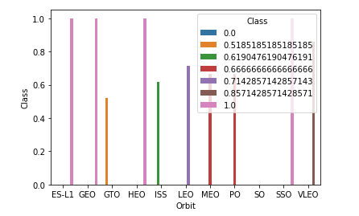
Success Rate vs. Orbit Type
From this plot, we can see that ES-L1, GEO, HEO, SSO have the most success rate

Slide 21

Flight Number vs. Orbit Type
This Flight Number vs. Orbit type plot shows that SSO is “all the time” successful orbit, for most of the other orbits, success rate improves over time(Flight Number)

Slide 22
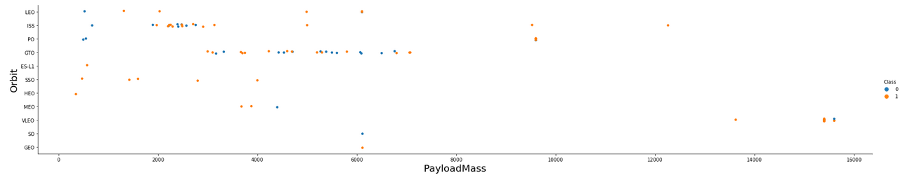
Payload vs. Orbit Type
Among the busiest launch sites, heavy load improves success percentage for LEO and SSO orbits and does not have any effect on SSO(100% success) and GTO(50/50 success/failure) orbits

Slide 23
Launch Success Yearly Trend
The success rate is improving since 2013, as shown on this chart

Slide 24
;
All Launch Site Names
The names of the unique launch sites: CAAFS LC-40, CAAFS SLC-40, KSC LC-39A, and VAFB SLC-4E
Query result:
A short explanation:
This query %sql select distinct(LAUNCH_Site) from SPACEXTBL; returns unique names only

Slide 25
Launch Site Names Begin with 'CCA'
Query: %sql select * from SPACEXTBL where LAUNCH_SITE like 'CCA%' limit 5;
Result with a short explanation: limit 5 returns only 5 records from SPACEXTBL like 'CCA%’ implies that the Launch Site Name must start with CCA.

Slide 26
Total Payload Mass
45596
The total payload carried by boosters from NASA:
Query: %sql select sum(PAYLOAD_MASS__KG_) from SPACEXTBL where CUSTOMER = 'NASA (CRS)';
Short explanation here:
Function sum calculates the total in the column PAYLOAD_MASS__KG_,
while where filters final result to apply to customer NASA (CRS) only

Slide 27
%sql select avg(PAYLOAD_MASS__KG_) from SPACEXTBL where BOOSTER_VERSION LIKE '%F9 v1.1';
Average Payload Mass by F9 v1.1
The average payload mass carried by booster version F9 v1.1: 2928.4
Query: %sql select avg(PAYLOAD_MASS_KG_) from SPACEXTBL where BOOSTER_VERSION LIKE '%F9 v1.1';
Short explanation:
Function avg calculates the average in the column PAYLOAD_MASS_KG_,
while where and LIKE filters final result to apply to booster versions starting with ‘F9 v1.1’ (F9 version

Slide 28
First Successful Ground Landing Date
Query: %sql SELECT MIN(date) AS first_successful_landing_outcome
FROM SPACEXTBL
WHERE LANDING__OUTCOME LIKE '%Success (ground pad)%’;
The result with a short explanation:
2015-12-22
Function MIN calculates the minimum date, while WHERE and LIKE filters final result to apply to successful ground landings only

Slide 29
Successful Drone Ship Landing with Payload between 4000 and 6000
Query: %sql SELECT BOOSTER_VERSION, LANDING__OUTCOME, payload_mass__kg_ FROM SPACEXTBL WHERE LANDING__OUTCOME LIKE '%Success (drone ship)%' AND payload_mass__kg_ > 4000 AND payload_mass__kg_ < 6000;
The result with a short explanation:
SELECT function gets only the booster versions, WHERE and LIKE applied to successful landing outcomes on drone ships only, AND is used to specify an additional condition(payload being between 4000 kg and 6000 kg range)
booster_version
F9 FT B1022
F9 FT B1026
F9 FT B1021.2
F9 FT B1031.2

Slide 30
Total Number of Successful and Failure Mission Outcomes
Query: %sql SELECT COUNT(MISSION_OUTCOME) FROM SPACEXTBL WHERE MISSION_OUTCOME = 'Success’ or MISSION_OUTCOME = Failure(in flight)';
The result: 100

Slide 31
Boosters Carried Maximum Payload
Booster_Version
F9 B5 B1048.4
F9 B5 B1049.4
F9 B5 B1051.3
F9 B5 B1056.4
F9 B5 B1048.5
F9 B5 B1051.4
F9 B5 B1049.5
F9 B5 B1060.2
F9 B5 B1058.3
F9 B5 B1051.6
F9 B5 B1060.3
F9 B5 B1049.7
Query: %sql select BOOSTER_VERSION from SPACEXTBL where PAYLOAD_MASS__KG_ = (select max(PAYLOAD_MASS__KG_) from SPACEXTBL)
The result:

Slide 32
2015 Launch Records
Query: %sql SELECT LANDING__OUTCOME, BOOSTER_VERSION, LAUNCH_SITE,
from SPACEXTBL WHERE (LANDING__OUTCOME = 'Failure (drone ship)') AND (
LIKE '%2015%');
The result with a short explanation:
Only 2 missions failed in 2015.
landing__outcome | booster_version | launch_site | DATE
Failure (drone ship) | F9 v1.1 B1012 | CCAFS LC-40 | 2015-01-10
Failure (drone ship) | F9 v1.1 B1015 | CCAFS LC-40 | 2015-04-14

Slide 33
Rank Landing Outcomes Between 2010-06-04 and 2017-03-20
Query: %sql SELECT Landing_Outcome, Count(*) AS Count_Outcomes FROM SPACEXTBL
WHERE DATE BETWEEN ‘2010-06-04’ AND ‘2017-03-20’ GROUP BY Landing_Outcome ORDER BY Count_Outcomes DESC;
The result:
number | landing__outcome | ranking
10 | No attempt | 1
5 | Failure (drone ship) | 2
5 | Success (drone ship) | 2
3 | Controlled (ocean) | 4
3 | Success (ground pad) | 4
2 | Failure (parachute) | 6
2 | Uncontrolled (ocean) | 6
1 | Precluded (drone ship) | 8

Slide 34

Section 3

Slide 35
Launch Sites
Folium map shows all launch sites’ location markers on a global map

Slide 36

Folium Map: color-labeled launch outcomes
A folium map with an example of the color-labeled launch outcomes, green-success, red-failure

Slide 37
Launch Site Distances to its Proximities
51.43 KM from the nearest International Airport

Slide 38

Section 4

Slide 39
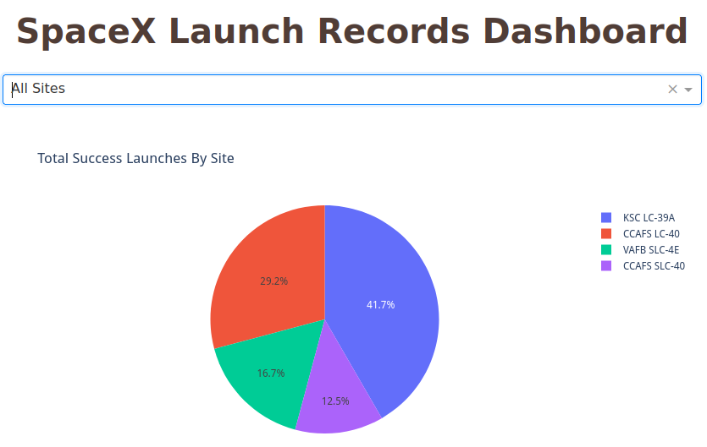
Pie Chart of Successful Landings For All Launch Sites
KSC LC-39A (Florida) has the highest number of successful launches

Slide 40
Pie chart for the launch site with highest launch success ratio
Pie chart for the launch site with highest launch success ratio is KSC, 76.9% of all launches were successful!

Slide 41
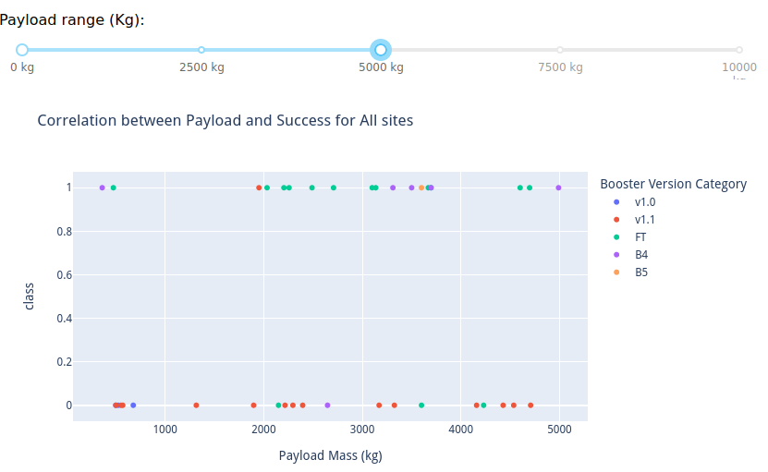
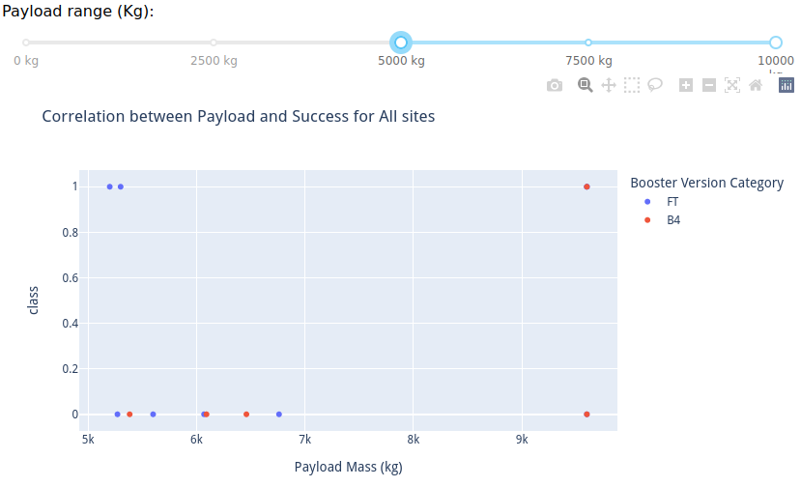
Payload vs. Launch Outcome for All Sites
The plots presented above, clearly show that lower payloads result in higher success rates and the FT booster version has the largest success rate amongst all other boosters.

Slide 42

Section 5

Slide 43
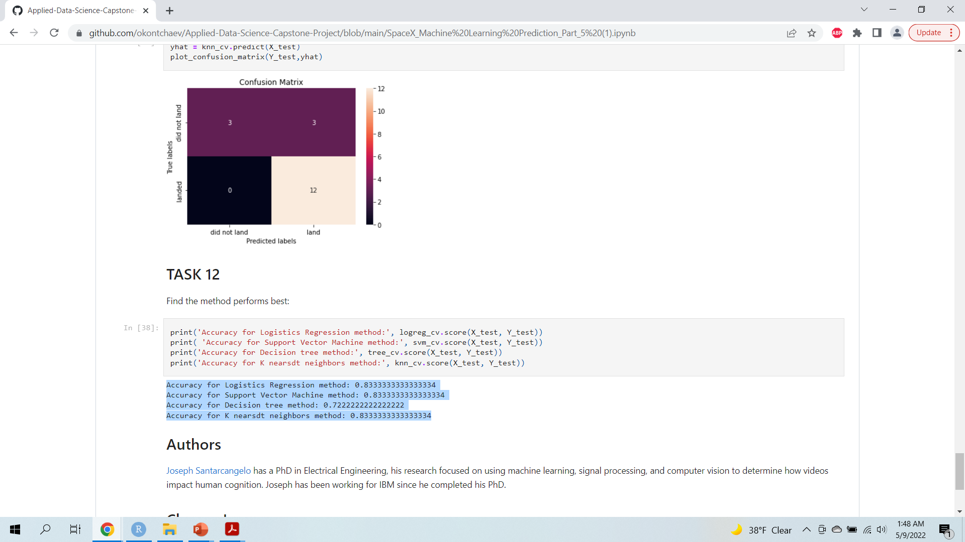
Classification Accuracy
The machine model that has the lowest classification accuracy is the Decision Tree Classifier at 72.22 %, all other models reached the accuracy of 83.33%

Slide 44
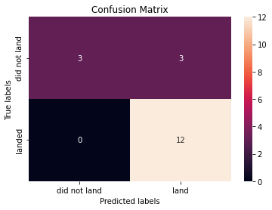
Confusion Matrix
This is KNN Confusion Matrix. Along with SVM and LR it performed better then DT model.

Slide 45
Conclusions
Launch success rate started to increase in 2013 till 2020.
The success rate is generally increasing over time
Launch site KSC LC-39A has the highest success ratio and the most successful launches
Orbit types GEO, HEO, SSO and ES-L1 had the best success rate
The Decision Tree Classifier has shown the less effective Machine Learning Algorithm in this project. SVM, Logistic Regression and KNNs has shown equal results

Slide 46
Appendix
You are welcome to visit my GitHub repo at:
https://github.com/okontchaev

Slide 47


